Slide 1

Transfer Learning using Inception v3 2015 - t-SNE

Slide 2

Reference
Chapter 13 (O'Reilly) of Hands-On ML
Hvass Lab’s GitHub and Youtube
Youtube on Inception v3 2015
Youtube on CIFAR10
Youtube on Pickle
Youtube on Transfer Values
Youtube on PCA of Transfer Values
Youtube
Code

Slide 3
Inception v3 2015 Download

Slide 4
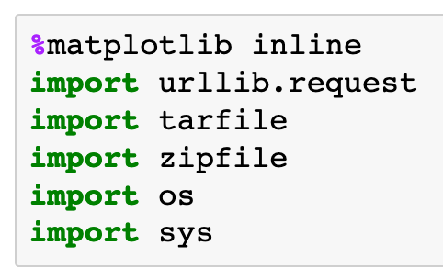

Slide 5
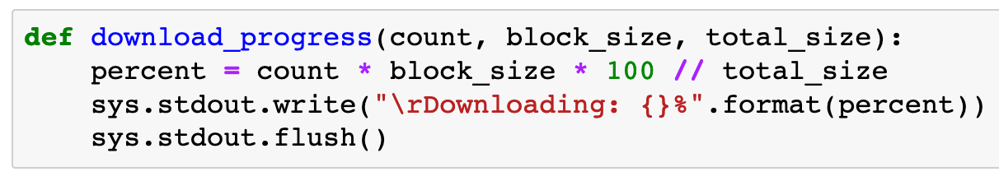

Slide 6
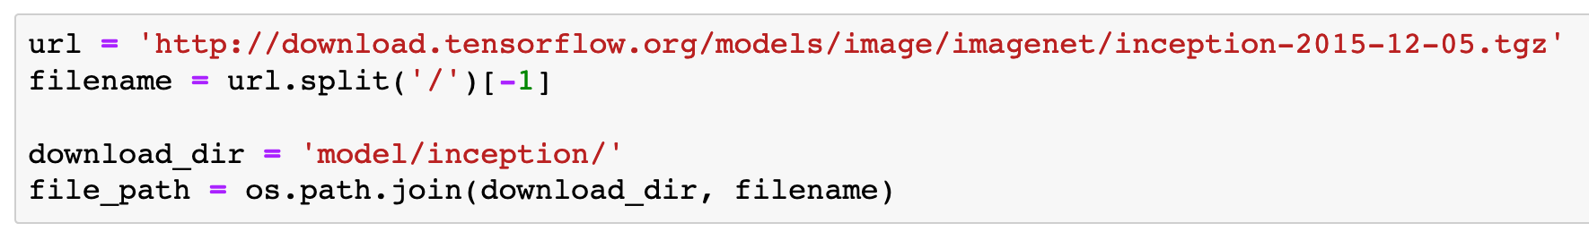

Slide 7
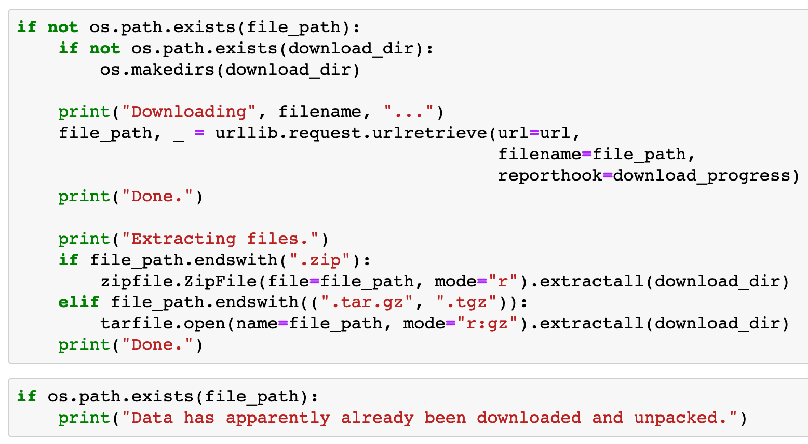

Slide 8
CIFAR10 Download

Slide 9
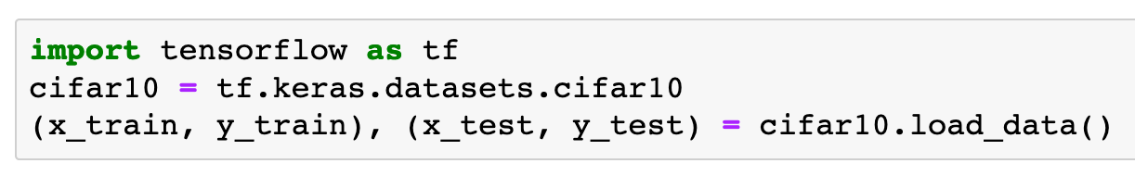

Slide 10
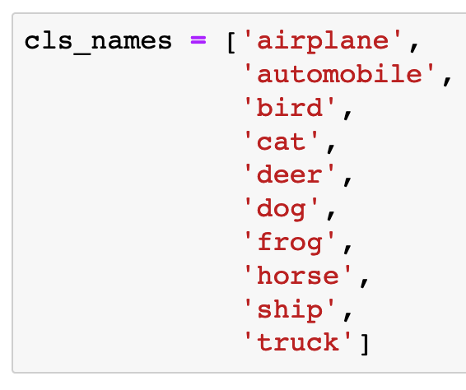

Slide 11
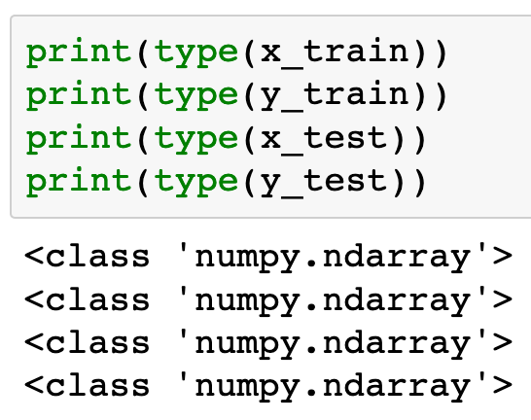

Slide 12
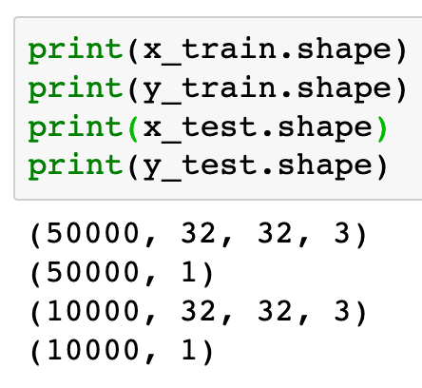

Slide 13
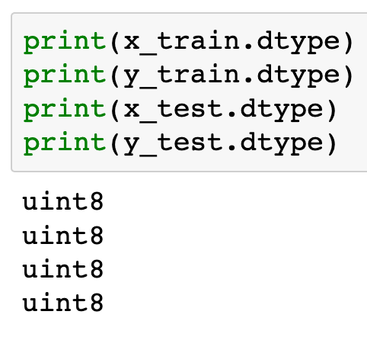

Slide 14
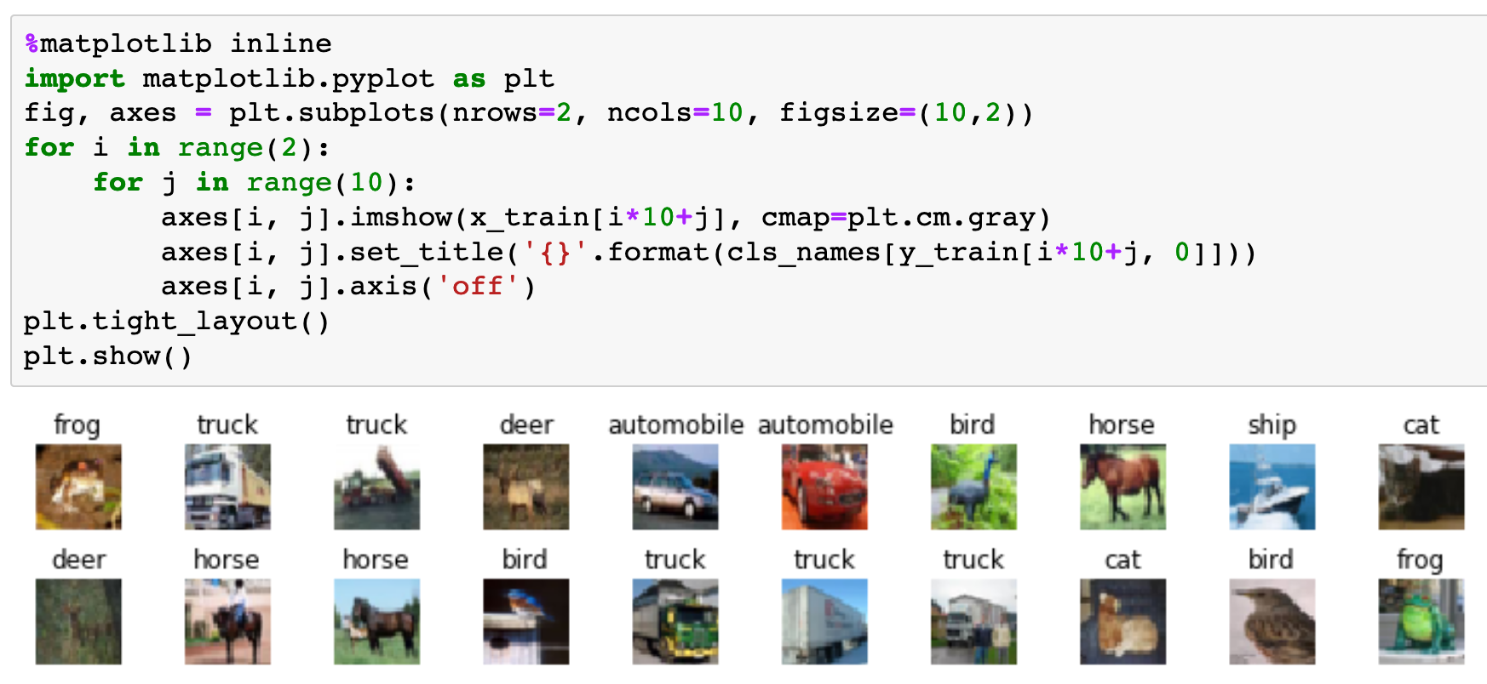

Slide 15
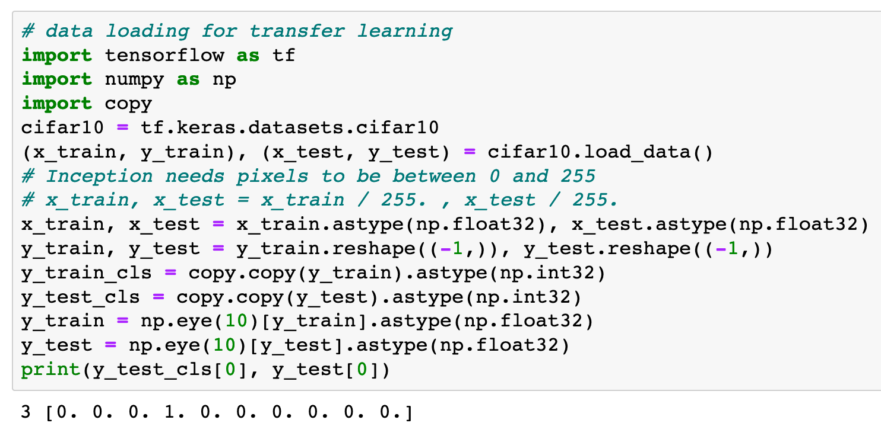

Slide 16
Restore Graph

Slide 17
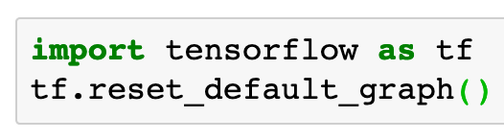

Slide 18
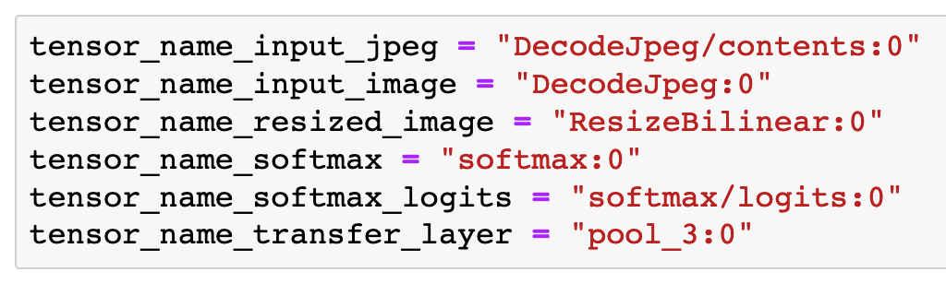

Slide 19
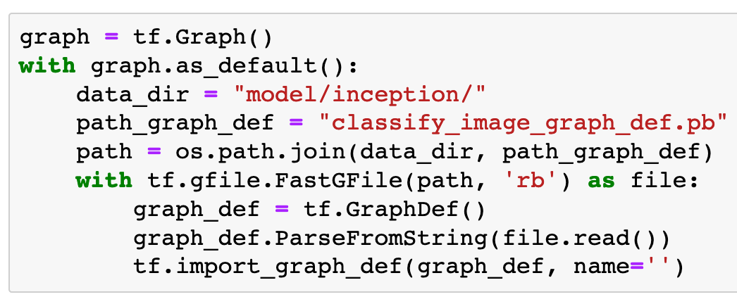

Slide 20
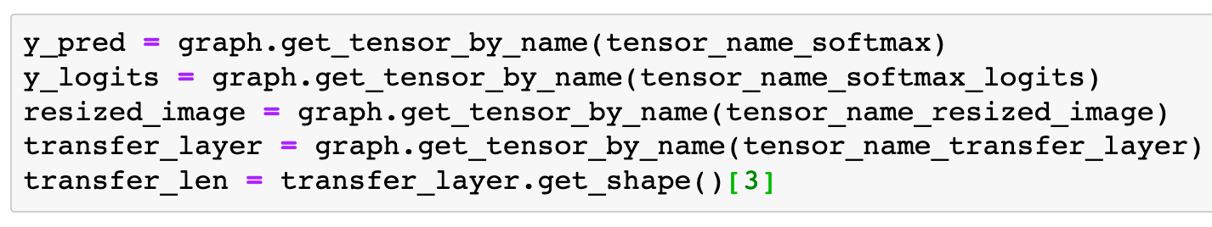

Slide 21
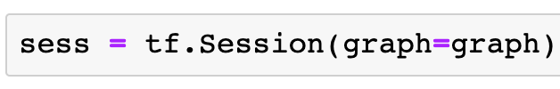

Slide 22
Compute Transfer-Values

Slide 24
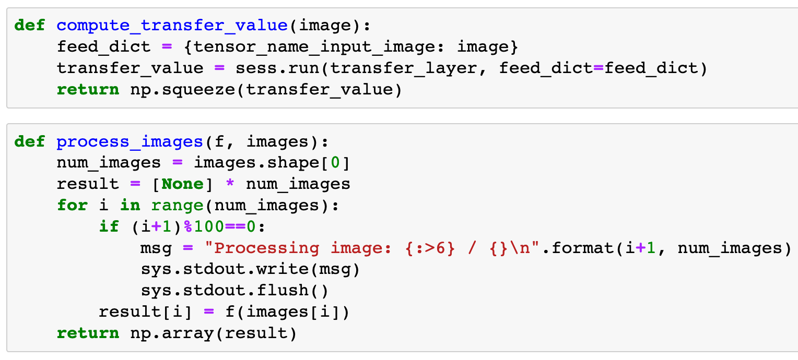


Slide 27
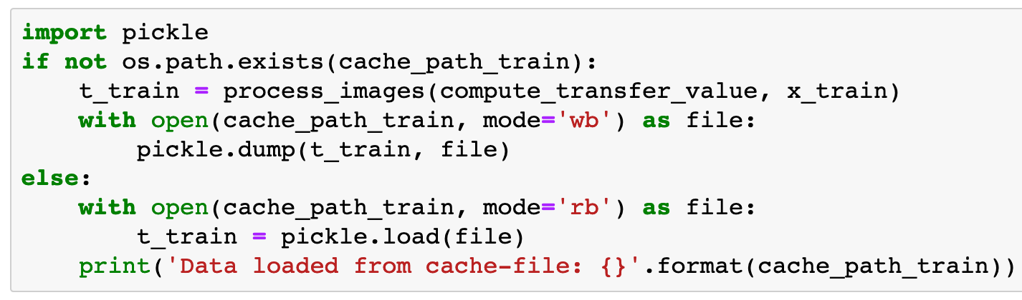
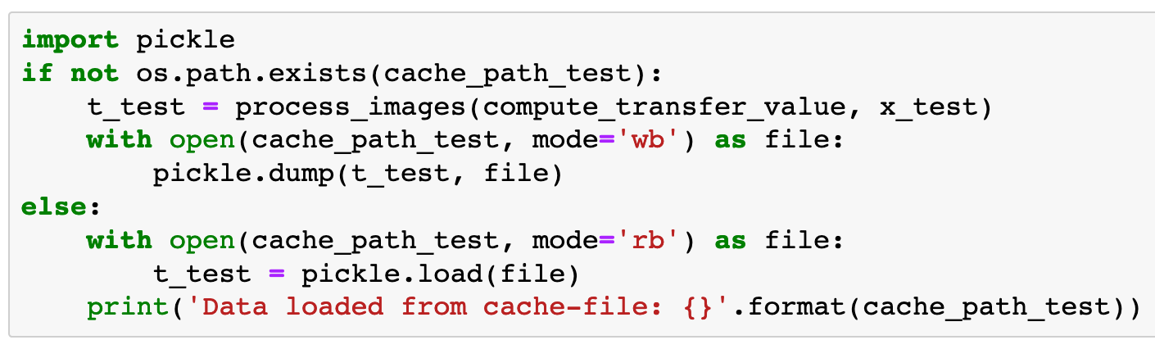

Slide 28
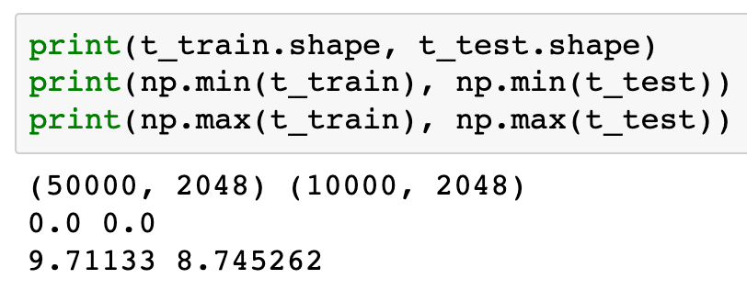

Slide 29
PCA

Slide 30
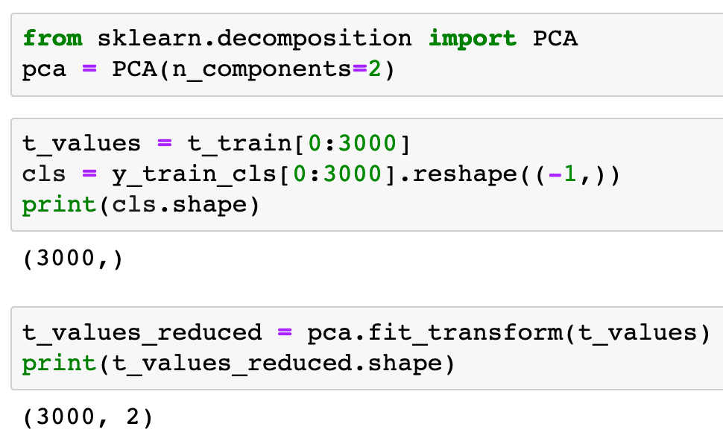


Slide 33
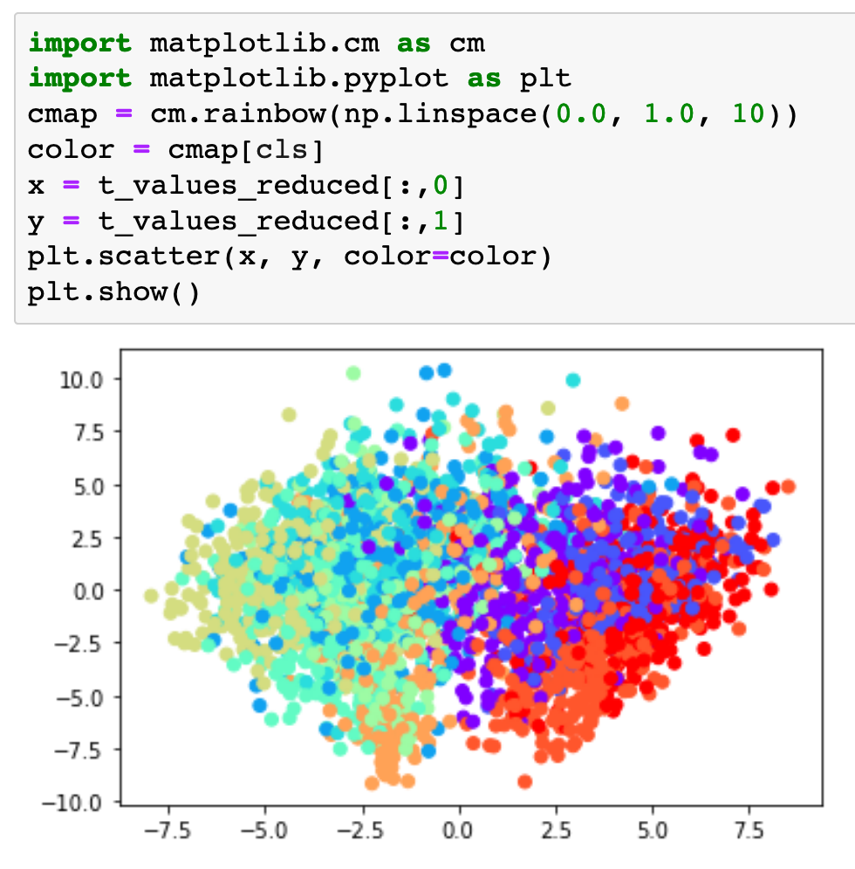

Slide 34
t-SNE

Slide 35
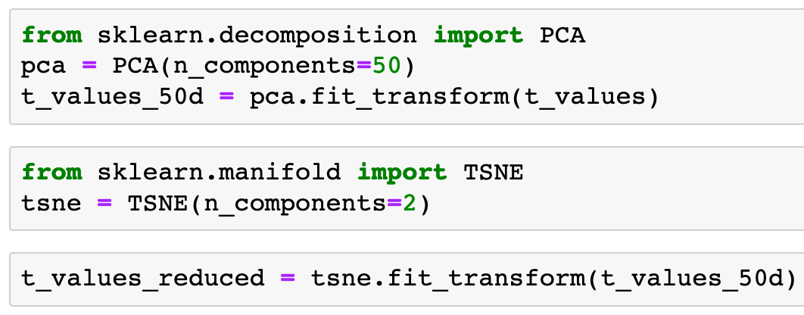

Slide 38
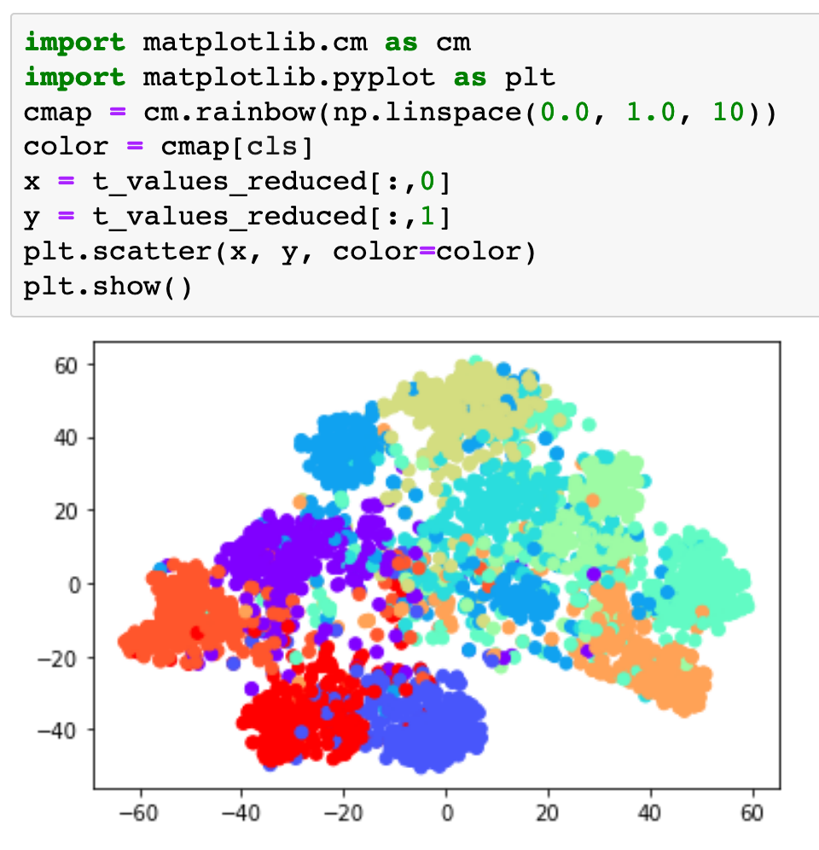

Slide 39
Now
Let’s Play with Code

